Slide 1
Unit #1: Immigration, Industrialization & Progressives
***Laissez Faire - theory that government stays out of business affairs
*** Gilded Age – boom of industry but not hid some underlying problems

Slide 2
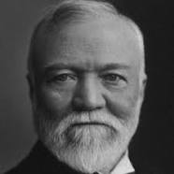
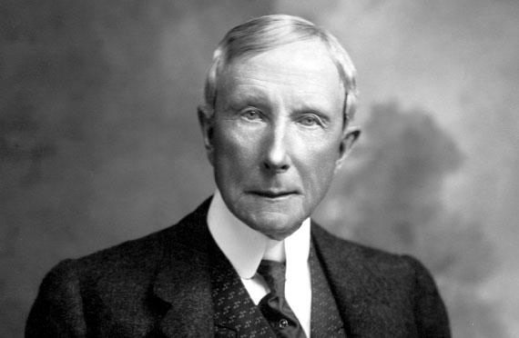
Industrialization
The recovery period after the Civil War led to increased industrialization.
Abundance of Natural Resources
Coal, Iron, Steel, Oil
Capitalism- an economic and political system in which a country's trade and industry are controlled by private owners for profit, rather than by the state.
Rise of big business: New inventions & corporations
Railroad- Cornelius Vanderbilt
RRs later suggested time zones
Steel- Andrew Carnegie
Social Darwinism- “natural selection,” supported his ideas of competition, hard-work & responsibility
Oil- John D. Rockefeller
Trusts- Firms or corporations that combine for the purpose of reducing competition and controlling prices Banking/investment
J. P. Morgan- invested in inventions & corporations, 1st billion dollar company (US Steel)

Slide 3
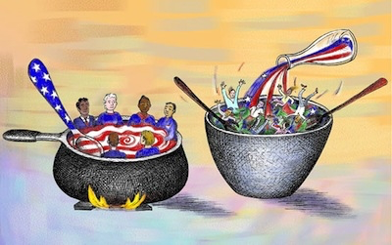
Immigration
New businesses needed workers-
Emigrants- farmers moving to the city
Immigrants- from other countries
Old Immigrants- north & west Europe, especially 1860s-1890s
New Immigrants- mainly southern & eastern Europe, Asia, 1890s-1920s,
Various push/pull factors
Assimilation theories:
Melting Pot- blending
Salad Bowl- things stay the same
Nativism-
Anti-immigrant ideas
Believed “native born” white Americans were superior

Slide 4
Immigration
Immigration Stations:
had to pass inspections, pass literacy tests in native languages, had to have $25, prove they were able to work
Ellis Island- east coast of the US, NYC
16M – at peak 11,000 per day!
Angel Island – west coast of the US, San Francisco
Treatment of Labor-
Seamstress- 12 hour day, 6 days a week
Steel Workers- 7 days a week (swing shift)
Wages were so low that every member of the family had to work to survive
Child labor- 25% of boys & 10% of girls under 15 worked
No vacation time, sick days, unemployment, maternity leave, disability
Income 1899-
women & children had average pay of $269/year
Men’s average pay of $498/year

Slide 5
Captains of Industry vs. Robber Barons
Monopolies- drive out all competition
Vertical Integration- own all the means of production to create a product (Andrew Carnegie- 1899, made $23M w/ no income taxes)
Horizontal Integration- own all of the companies in an industry (John D. Rockefeller)
Philanthropy- donate to charities
Examples: Carnegie Hall, Vanderbilt University, Duke University, Stanford University, etc.
Political Machines- offered services to voters & businesses in exchange for political or financial support
Political bosses controlled many cities (Boss Tweed- NYC, “Big Jim” Pendergast

Slide 6
Rise of Labor
Socialism- an economic & political system based on gov’t ownership/control/regulation of business & property and on equal distribution of wealth
Founders- Karl Marx & Frederick Engels
Labor Unions: an organized association of workers, often in a trade or profession, formed to protect and further their rights and interests.
American Federation of Labor (AFL) – skilled workers, Samuel Gompers
Congress of Industrial Organization (CIO) – merged with AFL
American Railway Union – railroad workers, Eugene V. Debs
Industrial Workers of the World (Wobblies) – unskilled workers, William Haywood

Slide 7
Labor Terms:
Sweatshop – factory in which workers are employed for long hours at low wages under unhealthy conditions
Company Towns – living areas connected to production of facilities
Strike – work stoppage, refusal of employee to work
Scab – person who takes the job of a worker who is on strike
Pinkertons – private security hired to break strikes
Collective Bargaining – negotiations between workers & employers to reach an agreement on working conditions, pay, etc.
Arbitration – (mediation) settling a dispute in which both parties to abide by the decision of an outside party (arbitrator)

Slide 8
Opposition to Unions
Great Strike of 1877 –
RR workers went on strike
Ended when Pres. Hayes brought fed. troops in
Haymarket Affair – 1886
Bomb exploded in the middle of striking workers
Homestead Strike – 1892 Carnegie Steel
Workers went on strike after wage cut
Hired Pinkerton Detective Agency to protect scabs
Battle between strikers & detectives, 3 detectives & 9 strikers dead
Triangle Shirtwaist Factory Fire – 1911
Exits locked, no fire escapes, 146 women died

Slide 9
Grange Movement & Populism:
Grange started as a social movement of farmers who wanted the gov’t to control the RRs & storage of grain
Grassroots movement for change in state laws
Populism – movement of farmers & labor workers organized into the Populist Party (People’s Party)
Platform:
Bi-metalism – using gold & silver to increase money supply & lower the value of money
Direct Election of Senators
Secret ballot elections
Graduated Income Tax
Leader – William Jennings Bryan – Cross of Gold Speech
https://youtu.be/HeTkT5-w5RA

Slide 10
Progressivism
Progressivism – movement seeking to return control of gov’t to the people, restore economic opportunities & correct injustices in American life
4 Goals:
Protecting Social Welfare
Settlement houses, YMCA, Salvation Army, No child labor
Promoting Moral Improvement
Temperance Movement, Prohibition
Creating Economic Reform
Panic of 1893 – railroads caused banks to close
Socialism, Muckrakers (journalists who wrote about corruption in business & govt)
Upton Sinclair- “The Jungle”- Pure Food & Drug Act, Meat Inspection Act
Foster Efficiency –
Scientific management – using science to increase efficiency in the workplace
Ford Motor Company- $5/day wage, 8 hour day (2x other workers in US)

Slide 11
Political Reforms
Early Changes:
Munn vs. Illinois- 1877
Sup. Ct. allowed government to regulate private industry
Interstate Commerce Act- 1886
Sup. Ct. ruled that states could set rates on inter-state commerce
ICC set up to supervise RR activities by a committee of 5 members
Empower the People:
Initiative – a bill on the voting ballot that is originated by the people, rather than the lawmakers
Referendum – voters are allowed to approve or reject a law that the legislature has passed
Recall – the voters have the opportunity to reject & remove an elected official

Slide 12
Progressive Amendments
Pendleton Civil Service Reform Act (1883) – established that positions within the federal government should be awarded on the basis of merit instead of political affiliation.
16th Amendment – 1913 – Progressive (graduated) Income Tax
17th Amendment – 1913 – Direction Election of Senators
18th Amendment – 1919 - Prohibition
19th Amendment – 1920 - Women’s Suffrage

Slide 13
Segregation & Discrimination
Jim Crow Laws – state laws permitting segregation (separating whites and blacks) in public & private facilities
Voting restrictions based on race-
Literacy tests
Poll taxes – pay to vote
Grandfather clauses – he could vote if his father or grandfather had been eligible to vote before January 1, 1867
Early Civil Rights leaders:
Booker T. Washington – promoted practical skills, such as agriculture or mechanical work, created the Tuskegee Institute
W.E.B. Du Bois – talented 10th to lead blacks, educate the most talented & lead the group
Founded the Niagara Movement – 1905, named for the "mighty current" of change the group wanted to effect

Slide 14
Segregation & Discrimination
Marcus Garvey- founded the Universal Negro Improvement Association, encouraged black to move back to Africa & create a great kingdom
NAACP - National Association for the Advancement of Colored People, is a civil rights organization founded in 1909 to fight prejudice, lynching, and Jim Crow segregation, and to work for the betterment of "people of color."
W. E.B. Du Bois & Ida B. Wells were among the original founders
Charles Eastman – Native American civil rights leader, founder of the Boy Scouts, began 32 chapters of the YMCA

Slide 15
Progressive Era Presidents
26th – Teddy Roosevelt (R) – youngest president to hold office after McKinley was assassinated
Known as the “Progressive President” – “Trust Buster”
“Square Deal” – believed in good & bad trusts
27th – William Howard Taft (R) – picked by TR
Broke up more trusts than TR
Angered TR when he broke up “good trusts”
28th – Woodrow Wilson (D) –
Republicans split during election – Republicans (Taft) vs. Bull Moose (TR)
Created Federal Reserve System
Graduated Income Tax
Women’s suffrage attained during presidency

