Slide 1
Unit #2: American Imperialism

Slide 2
American Expansionism
Americans had always sought to expand the nation
Imperialism- policy in which stronger nations extend their economic, political, or military control over weaker territories
Many European nations had already established colonies around the world
Europeans target Africa- only Ethiopia and Liberia were independent nations at the start of the 20th century
European nations also controlled parts of China

Slide 3
American Expansionism
Most Americans want U.S. to seek overseas colonies
3 factors contribute to this belief:
Desire for military strength- led to a building up of the navy
Thirst for new markets- saw foreign trade as a solution to overproduction
Belief in cultural superiority- idea of Social Darwinism used to justify imperialism

Slide 4
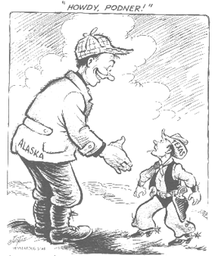
U.S. Acquires Alaska
1867 Secretary of State William Seward buys Alaska from Russia for $7.2 million
Approximately 2 cents/acre
Many people referred to this action as ‘Seward’s Icebox’ or ‘Seward’s Folly’ seeing little value in the land
However, Alaska is a land rich in oil, timber, and minerals

Slide 5
U.S. Acquires Hawaii
America used Hawaii as a staging point for trade with East Indies and China as far back as the 1790s
Some Americans stayed on the islands and began growing sugar whom they sold to the United States
1875 America agrees to import Hawaiian sugar duty-free
This decision reversed as a part of the McKinley Tariff in 1890
Many call for the U.S. to annex Hawaii to eliminate this tax
1887 - U.S. builds naval base, Pearl Harbor, in Hawaii
1893 - American Planters overthrew Queen Liliuokalani
August 12, 1898 Hawaii is annexed by the United States

Slide 6
The Spanish-American War Cubans Rebel Against Spain
By 1900 Spain has only a few of its colonies left: the Philippines, Guam, Cuba, and Puerto Rico
For a long time America had its eye on Cuba
Spain refused to sell Cuba to America saying they would ‘rather see it sink into the ocean’.
Jose Marti launches a revolution for Cuban independence against Spain in 1895
Utilizes guerilla tactics
Public opinion in the United States divided over whether the US should join the conflict

Slide 7
War Fever Escalates
American newspaper reporters sent to Cuba to give accounts of the conflict
Many exaggerate their stories to provoke US involvement and to sell more newspapers
Yellow Journalism- sensational style of writing which exaggerates the news to lure and enrage readers
De Lome Letter- leaked letter from the Spanish ambassador to the US which called President McKinley ‘weak’ and a ‘bidder for the admiration of the crowd’

Slide 8
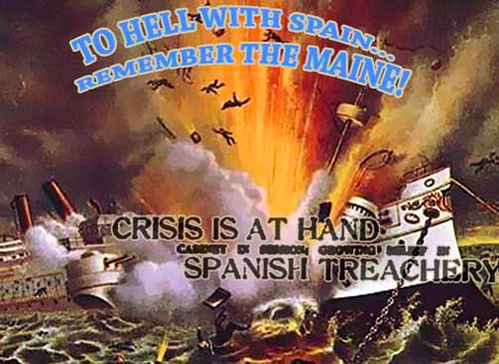
February 15, 1898 the USS Maine blows up in Havana harbor killing 260 men
Newspapers describe the Spanish intentionally blowing up the ship
In all likelihood it was a mechanical failure

Slide 9
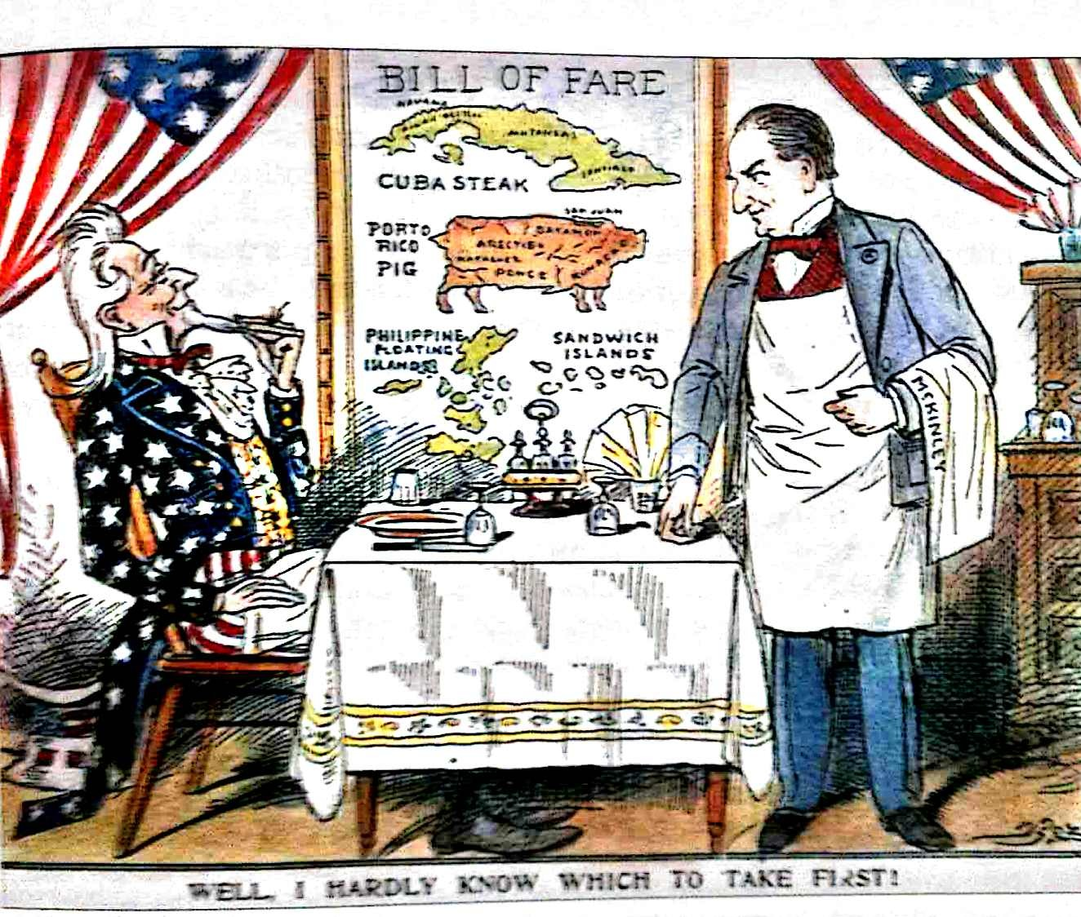

Slide 10
War with Spain
First fighting of the war took place in the Philippines where Spain’s naval fleet was destroyed
US is victorious by August
US Navy successfully completes blockade of Cuba
17,000 American forces land in Cuba in June 1898
2 Black regiments & the Rough Riders won a victory at Kettle Hill which allowed infantry to win a battle at San Juan Hill
After defeating the Spanish in Cuba, US forces invade Puerto Rico in late July
Treaty of Paris- US gets Guam and Puerto Rico, buys the Philippines for $20 million and Cuba is freed
Domestic debate ensues over whether or not the US has the right to annex the Philippines
Some fear competition for American jobs, others fear potential difficulties in race relations, others feel a sovereign nation should be left to govern itself

Slide 11
America Acquires New Lands: Ruling Puerto Rico
Question erupts over what to do with Puerto Rico
Many Puerto Ricans divided- some push for local government as a US territory, others wish to become a state
During the Spanish-American War, Puerto Rico occupied and controlled by the US military
1900- Foraker Act- gave US president the power to appoint governor of Puerto Rico
Puerto Ricans eventually granted right to elect members of their legislature and US citizenship

Slide 12
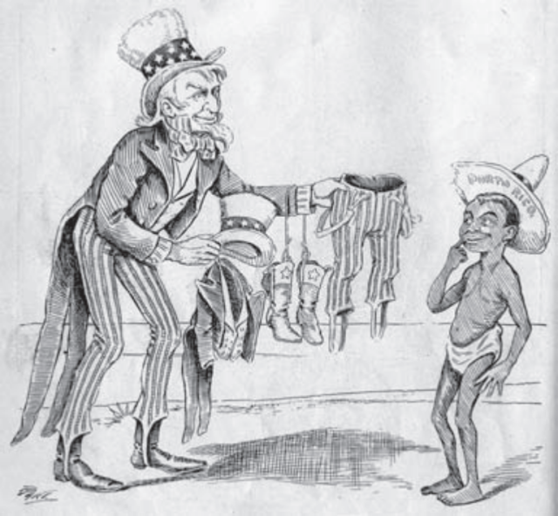
Cuba and the US
Cuba granted independence following
the Spanish-American War
Cuba ratifies a new constitution in 1903
and becomes a US protectorate for
31 years- country whose affairs are partially controlled by a stronger power
Platt Amendment
Cuba could not make treaties the might limit freedom
US has the right to intervene in Cuba
Cuba could not go into debt that they couldn’t repay
US could buy or lease land for military use
Americans kept presence in Cuba to protect American business interests there- sugar, tobacco, and mining

Slide 13
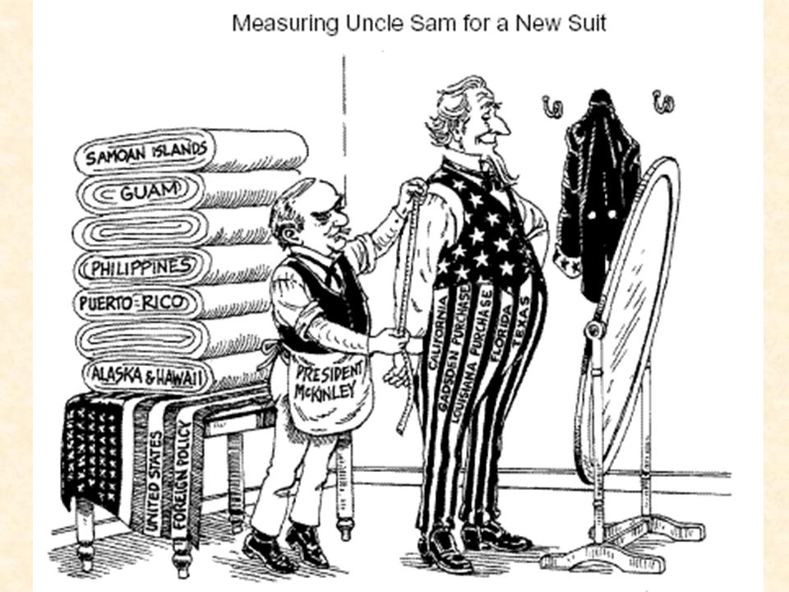
Filipinos Rebel
Filipinos outraged by annexation of their country by the US
1899 Emilio Aguinaldo leads revolt against the US
Takes US 3 years, 4,000 lives and $400 million dollars to put down the rebellion
Government established in the Philippines similar to the one in Puerto Rico
Philippines achieves independence on July 4, 1946
US viewed the Philippines as a gateway to trade in Asia, specifically China

Slide 14
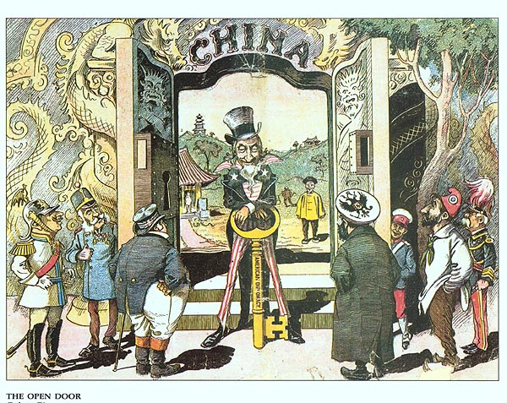

Slide 15
Foreign Influence in China
Many nations compete for economic interests in China
Each nation typically controlled a small region of the country along the coast where they had special trading and legal rights
John Hay’s Open Door Notes allowed for sharing of trading rights in China by a number of nations
Western nations come to dominate most of China’s large cities through trade
Group of Chinese, known as the Boxers, lead rebellion in 1900 protesting foreign involvement in their country
Eventually put down by a number of western nations
US feels strength of its economy based on exports and access to open foreign markets

Slide 16
Impact of US Territorial Gains
Anti-Imperialism groups grew in the 20th century:
Prominent Americans such as Grover Cleveland, Andrew Carnegie, and Mark Twain joined the movement
Believed it was wrong for the US to rule other people without their consent even if the US benefitted economically

Slide 17
America as a World Power: Teddy Roosevelt and International Politics
Teddy Roosevelt ascends to the Presidency following the assassination of President McKinley in 1901
Russia and Japan go to war in 1904 over control in Korea
Roosevelt works as a mediator for peace negotiations in New Hampshire in 1905 – Won the Nobel Peace Prize
Agreement helped establish positive relationship between US and Japan

Slide 18
Panama Canal
Many Americans favor a canal across Central America to reduce travel time for commercial and military ships
Two options come to the forefront: one through Nicaragua and another through Panama
US decides to go through Panama
Problem: Panama was a Colombian province
Colombia won’t grant US permission to build so US influences start of a rebellion in Panama
Rebellion succeeds and Panama gains independence
Panama then sells canal zone to US for $10 million and an annual rent of $250k

Slide 19
Building the Canal
Much of land around the canal zone contains swamps and mountains
One huge problem for workers is disease- yellow fever and malaria
Work begins in 1904
At the height of construction 43,400 workers employed
5,600 workers die from accidents or disease
Canal opens on August 15, 1914- total construction cost to the US $380 million

Slide 20
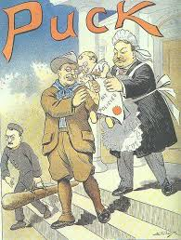
Roosevelt Corollary
US drawn further into Latin American affairs
US government fears European involvement in Latin America
“Speak softly and carry a big stick”
1904 Roosevelt adds the Roosevelt Corollary to the Monroe Doctrine- basically stated the US would use force to protect its economic interests in Latin America

Slide 21
Taft’s Dollar Diplomacy
1911 rebellion in Nicaragua left the nation bankrupt
US bankers loan government money to pay off their debts in exchange for control of country’s railroad system and national bank
Nicaraguan citizens hear about the deal and attempt to overthrow their president
US Marines quell the rebellion
Dollar diplomacy- US policy of using the nation’s economic power to exert influence over other countries

Slide 22
Wilson’s Missionary Diplomacy
‘Missionary Diplomacy’- President Wilson’s view that the US had a moral responsibility to deny recognition to any LA government it viewed as oppressive, undemocratic, or hostile to US interests
Pressured nations in the Western Hemisphere to establish democratic governments

Slide 23
Mexican Revolution
Mexico long ruled by Porfirio Diaz, dictator who encouraged foreign investment in Mexico
Foreign investors and a few Mexicans become rich while common people are desperately poor
1911 Mexican peasants overthrow the government
Series of governments come to power at this time in Mexico
US Marines get involved in the conflict in 1914 and the US and Mexico nearly go to war
Pancho Villa and Emiliano Zapata lead a revolt against Mexican government beginning in 1916
Villa and Zapata are dedicated to land reform
During their revolt, some of Villa’s followers raid Columbus, NM killing 17 Americans

Slide 24
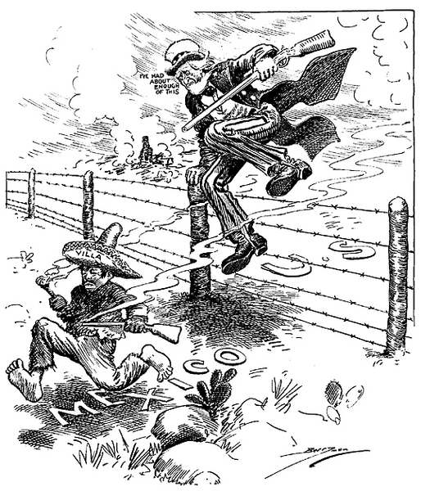
Mexican Revolution
American public is outraged and demand Villa’s capture
General John J. Pershing and 15,000 US soldiers goes to Mexico in search of Villa

Slide 25
Legacy of Conflict with Mexico
Many Mexicans grow angry over US military presence on their land- clash ensues between US and Mexican armies
Pershing eventually goes home as US military focuses on war in Europe
Illustrated Americans belief in the superiority of free-enterprise democracy
Showed American government’s willingness to militarily get involved to preserve American economic interests in a foreign country

