Slide 1
Unit #8: The Sixties

Slide 2
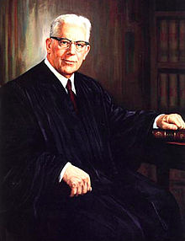
Civil Rights Movement
Brown v. Topeka Board of Education 1954
Ruled against Plessey v. Ferguson
Chief Justice Earl Warren wrote majority opinion
“Separate but equal” is unconstitutional

Slide 3
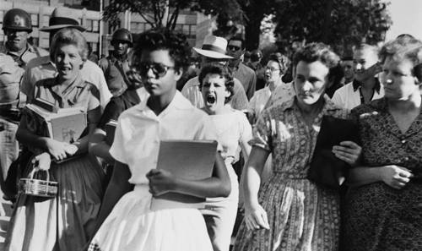
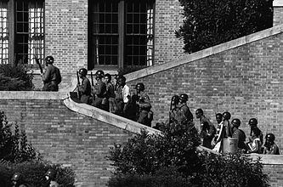
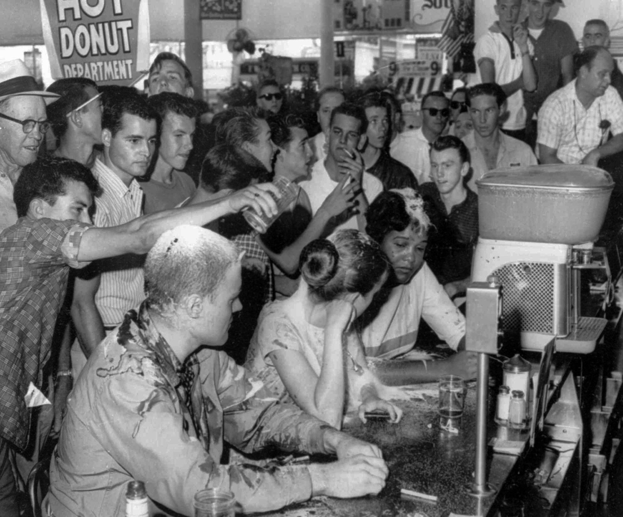
Civil Rights Movement
Rosa Parks
Black woman who refused to give up seat on the bus & bus boycott
1956 Montgomery buses desegregation
Civil Rights Act of 1957- voting rights for blacks secured.
1960’s sit-in protests begin at Woolworth’s lunch counter

Slide 4
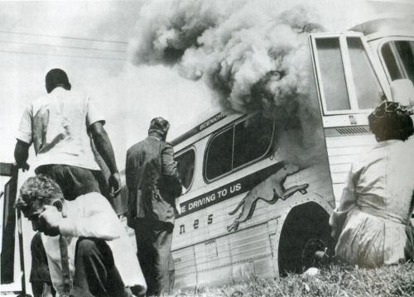
Civil Rights Movement
1961- Freedom Rides begin- challenge segregation
1962- James Meredith enrolls at Ole Miss
1963- MLK Jr. arrested for demonstrating at Birmingham, AL
Civil disobedience
“Letter from Birmingham Jail”

Slide 5
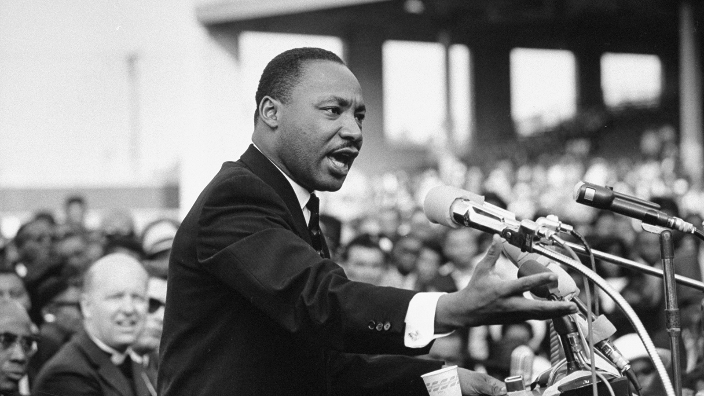
Civil Rights Movement
Medgar Evers- NAACP leader, murdered in his home
March on Washington- MLKs “I have a dream speech”
16th Street Baptist Church bombing- 4 young girls killed

Slide 6
Civil Rights Movement
1964- 24th Amendment abolishing poll taxes
SNCC & SCLC
1965- voting march in Selma, AL
Congress passes Voting Rights Act
1967- Loving v. Virginia- banning interracial marriage is unconstitutional

Slide 7
Civil Rights Movement
Assassination of MLK
Television helped movement!

Slide 8
Kennedy’s New Frontier
Kennedy v. Nixon 1960
Increase spending on space, national defense, hospitals & schools
Fidel Castro leads rebellion in Cuba & allies w/ USSR

Slide 9
Kennedy’s New Frontier
Bay of Pigs- CIA train Cubans to overthrow Castro
1961- 1,500 rebels defeated by Cubans & the US fails to help them
Berlin Crisis- USSR builds Berlin Wall in 1961

Slide 10
Kennedy’s New Frontier
Cuban Missile Crisis 1962:
U2 spy plane photographs missile launch pads
UN confronted USSR
“Quarantine” of Cuba
USSR dismantle bases in Cuba & we take weapons out of Turkey

Slide 11
Kennedy’s Assassination
Nov. 1963- Dallas, TX
Lee Harvey Oswald kills Kennedy
Jack Ruby shoots Oswald
Warren Commission- investigates and finds no evidence of a conspiracy

Slide 12
Johnson’s Great Society
Kennedy’s VP
Focus on:
Tax Cuts
Civil Rights
Poverty
1964 election - wins by a landslide

Slide 13
Vietnam War
France had controlled region until the 1950’s
North Vietnam-
Communist led by Ho Chi Minh & capital is Hanoi
South Vietnam-
Republic led by President Diem & capital is Saigon

Slide 14
Vietnam War
1960 Kennedy tries aid to SV
Diem assassinated
1964- US ships attacked by NV in Gulf of Tonkin
Johnson starts bombing NV
By 1966- 500,000 US troops in Vietnam

Slide 15
Vietnam War
Tet Offensive- surprise attack by NV during Tet Holiday (New Years)
US stop attack but many casualties
Anti-War demonstrations!

Slide 16
Cultural Revolution
Hippies- youth that revolt against the “establishment”
New ideas!
Rock Music
Protests:
U of C Berkeley- students protest war
Burn draft cards
Take over Columbia U

Slide 17
Women’s Movement
ERA- Equal Rights Amendment
Title IX equality of public funds in athletics & activities
Rachel Caron wrote “Silent Spring” – started environmental movement

Slide 18
Warren Court
1953-1969
Racial segregation, civil rights, separation of church & state, Miranda Rights
Many wanted to impeach him for being to radical!

Slide 19
Election of 1968
Johnson didn’t run again
Robert Kennedy – assassinated in CA during campaign
DNC in Chicago –
War protests viewed on TV

Slide 20
Election of 1968
Rep. Richard Nixon wins on the platform of:
Violence in US
Vietnam War (honorable end)
Civil Rights
1969- Woodstock!

Slide 21
End of the 60s
Gradual removal of troops
Final troops leave in 1975
Open up trade w/ USSR
Watergate scandal
Nixon resigns in 1974
Gerald Ford becomes 1st non-elected president!
Pardoned Nixon!

Slide 22
End of the 60s
1969- Man on the Moon
Neil Armstrong, Michael Collins, Buzz Aldrin

