Slide 1
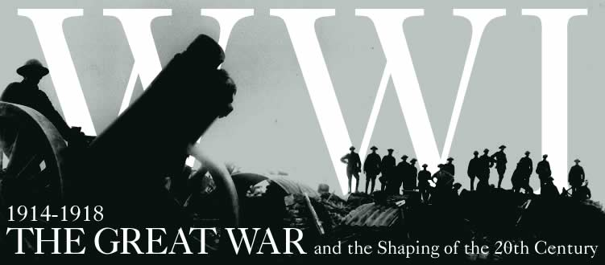
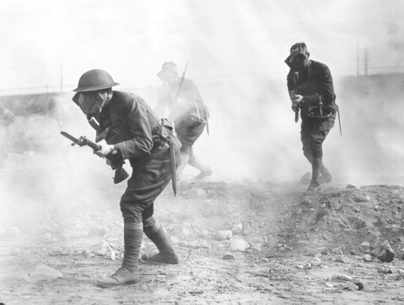
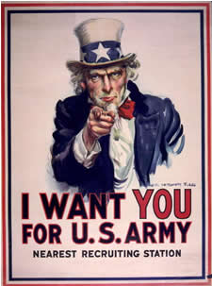
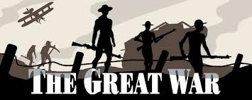
Unit #3 Great War

Slide 2
The War’s Causes
Militarism
Buildup of a nation’s armed forces
Was a result of imperialism- countries needed strong militaries to defend their colonies
Alliance System
2 major defense alliances in Europe on the eve of World War I
Triple Entente (Allies)= France, Britain, Russia
Triple Alliance (Central Powers)= Germany, Austria-Hungary, Italy, Ottoman Empire
Alliances were intended to prevent large-scale war, yet ended up starting the largest war in history at the time
Imperialism
Competition for colonies leads to rivalries between nations
Nationalism
Devotion to the interests and culture of your nation
Competition between nations

Slide 4
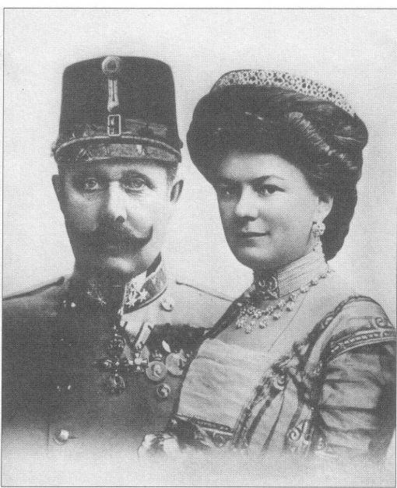
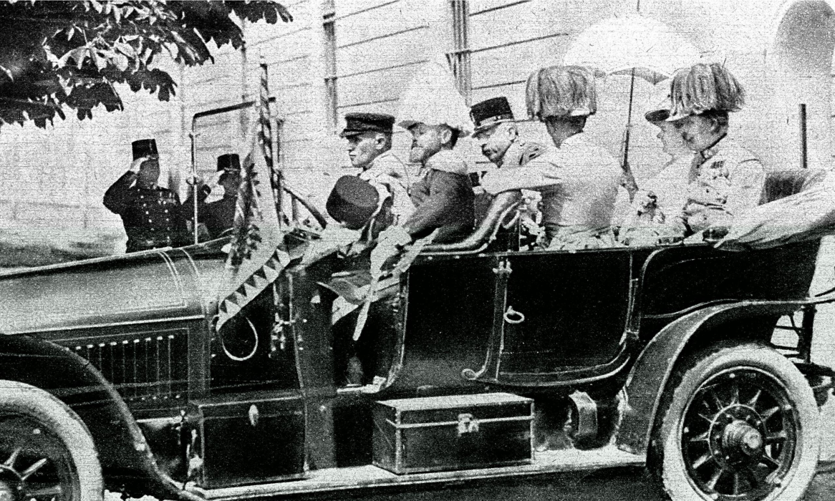
The Spark
Archduke Franz Ferdinand of Austria-Hungary visits Sarajevo, Bosnia in 1914
He is shot by a Serbian man while driving through the city
Austria-Hungary then declares war against Serbia
Alliance system draws more and more countries into the conflict

Slide 5
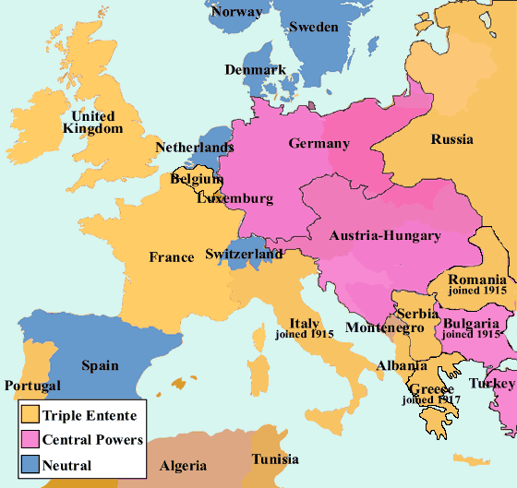
Triple Entente:
France
Russia
United Kingdom
US
Central Powers:
Austria-Hungary
Germany
Ottoman Empire

Slide 6
America: To Fight or not to Fight?
War Begins
1914- War starts with Germany invading Belgium on their way to France
Allies meet Germany in France
Schliffen Plan- Germany attack allies on two fronts (France & Russia)
Trench Warfare- style of battle where forces attack each other from fortified ditches- becomes commonplace
Between trenches lies No Man’s Land- unoccupied region between opposing army’s trenches
Many Americans view the war as a struggle between Germany and Britain for colonial control around the world
Newly arrived immigrants often sympathize with their former countries
Americans begin favoring the Allies due to strong economic ties with those nations

Slide 7
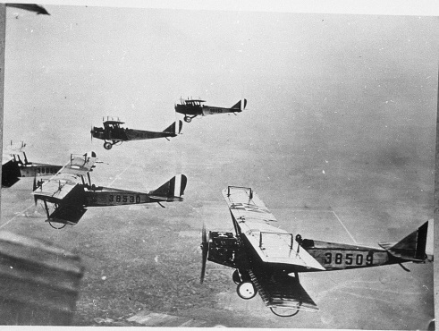
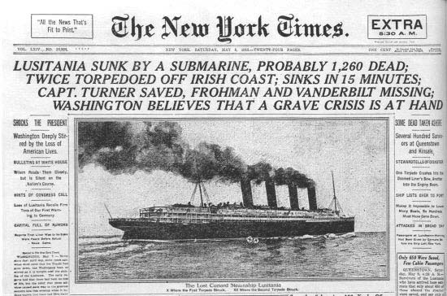
The War Hits Home
By 1917 America prepares for war for two reasons
1) Ensure Allies repay war debts
2) Prevent Germans from threatening shipping
Britain sets up blockade of Germany
In response German U-boats, submarines, set up counter-blockade around Britain
Germany sinks the British ship, Lusitania, in 1915 killing 128 Americans who were on board
German U-boats continue to sink Allied passenger ships
President Wilson re-elected in 1916
Wilson calls for peace and an end to the war after his re-election with little success

Slide 8
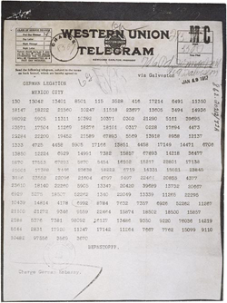
US Enters the War
January 31, 1917 Germany announces it will sink all ships in British waters
Zimmerman Note- message sent in 1917 by Germany to Mexico proposing a Germany-Mexico alliance in exchange for helping Mexico reclaim Texas, New Mexico, and Arizona
April 1917 the US enters the war to make the world ‘safe for democracy’

Slide 9
America turns the tide
To counteract the threat of German U-boats, Allies employ the convoy system- formation where a heavy guard of destroyers protects merchant ships
Greatly reduces shipping losses and casualties
Newly arrived American troops in Europe help lift Allied soldiers’ morale and enthusiasm
American ‘doughboys’- infantrymen- serve on the front lines
New weapons technology changes warfare
Machine guns
Tanks- used to drive through barbed-wire defenses
Airplanes- early on pilots shoot at each other with pistols until mounted machine guns are introduced aboard planes
Poison Gas (Mustard Gas)

Slide 10
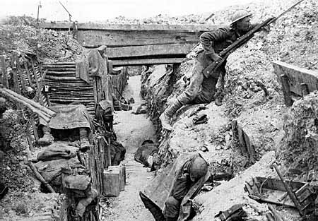
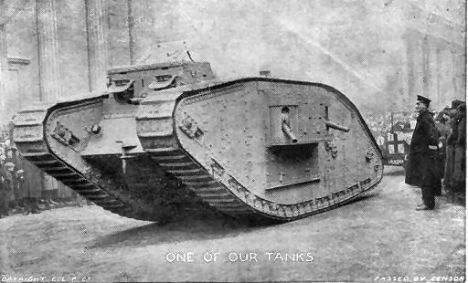
Hazards of warfare
Soldiers surrounded by lice, rats, and polluted water in trenches
‘Shell shock’- describes the emotional collapse experienced during war
Trench foot- disease caused by standing in cold wet trenches for long periods of time without drying out the feet
Feet literally begin to rot- only solution was amputation

Slide 11
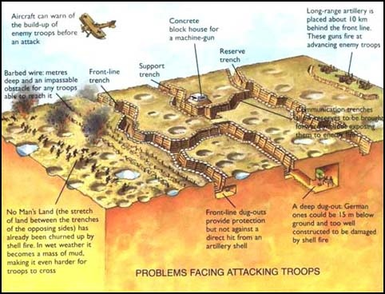

Slide 12
Allies go on the offensive
Russia pulls out of the war in 1917- causing Germany to place all its troops on the western front
With the assistance of US troops, Allies begin pushing Germans back and out of France

Slide 13
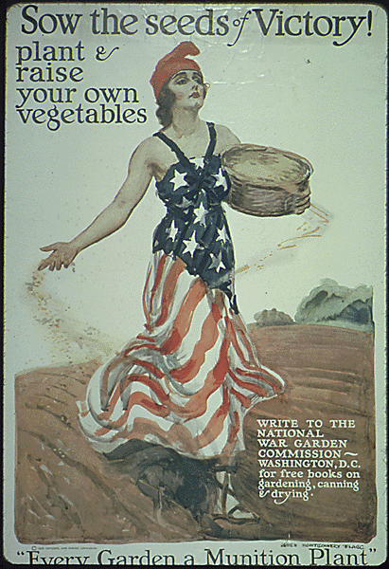
War’s costs
War deaths approximately 22 million
Another 20 million wounded and 10 million left homeless
Americans lose 48,000 in battle and another 62,000 to disease

Slide 14
Congress Gives Power to Wilson
For the first time, Americans understand how the home front impacts the war effort
Economy shifts from producing consumer goods to war supplies
To make the effort more efficient, government takes over control of much of the economy
War Industries Board- regulates the production of war supplies
Encouraged companies to mass produce

Slide 15
Congress Gives Power to Wilson
March 1918: Daylight Savings time introduced to save fuels
Wages jump heavily- however so did food prices and housing costs
Union membership booms as uneven pay between labor and management becomes common
Food Administration works to ration food- one day a week was ‘meatless’
Many people plant ‘victory gardens’- gardens at home allowing more food to be freed up for the troops

Slide 16
Selling the War
Government needs to raise money to pay for the war effort:
Progressive Income Tax- taxes higher incomes more than lower incomes
Bonds
Increased excise taxes on liquor, tobacco, and luxury goods
US government uses propaganda, communication designed to influence people’s thoughts and actions, to sell the war to the public
Propaganda usually in the form of paintings, posters, or cartoons

Slide 17
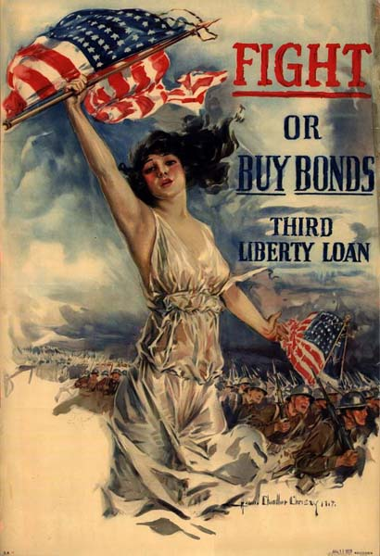
Selling the War

Slide 18
War Promotes Social Change
Many German-Americans experience attacks
Many Germans lose their jobs, orchestras refuse to play Mozart or Beethoven’s music
1918- Espionage and Sedition Acts- laws imposing harsh penalties on anyone interfering with or speaking against the US war effort
Thousands imprisoned for speaking out against the war
Opportunities arise for women during the war
Void left by men leaving and fighting allows many women to enter the workplace
Contributions of women to the war effort help lead to women gaining suffrage- the right to vote- in 1919
king out against the war and the draft

Slide 19
Flu Hits Home
Attacks on Civil Liberties
Great Migration- large-scale movement of hundreds of thousands of Southern blacks to cities in the North
Many blacks seek to leave behind discrimination in the South
Many more jobs available to workers in the North
Thousands migrate to industrial centers of the North: Chicago, New York, Philadelphia, Detroit
1918- influenza outbreak reaches the United States
Approximately 500,000 Americans die
Cripples the economy- many businesses temporarily shut down to avoid spreading the disease

Slide 20
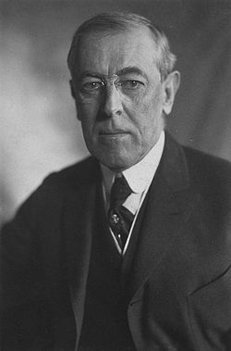
Wilson’s Peace Plans
Germany signs armistice, truce, to end the war on 11th hour of the 11th day of the 11th month, 1918
People of postwar Europe welcome Wilson with open arms
Wilson’s 14 Points:
1) There should be no secret treaties among nations
2) Freedom of the seas
3) Tariffs should be lowered or done away with to promote trade
4) Arms should be reduced during diplomatic crises
5) Colonial policies should include interests of those being colonized

Slide 21
Wilson’s Peace Plans (cont.)
14 Points:
Also stated distinct ethnic groups should form their own nation-states or decide for themselves what nation to join
14th point calls for a League of Nations- an international group designed to allow nations to come together and work to end conflicts
Reaction to Wilson’s Plan:
Most Allied leaders fail to share the same views as Wilson
Leaders of France and Britain were angry about German aggression during the war
Wanted to make Germany pay for escalating the war

Slide 22
Treaty of Versailles
Established nine new nations including Poland
Gave territories of the former Ottoman Empire to France and Britain
Barred Germany from possessing an army
Forced Germany to pay reparations- war damages- of $33 billion to the Allies
Impact:
Treaty lead to future German aggression by humiliating the nation- forced Germany to sign a war-guilt clause
Because Russia didn’t take part in the treaty it lost a great deal of territory
Ignored the self-determination of colonized peoples around the world
Many Americans disapprove of the creation of the League of Nations- after stiff resistance US fails to join League

Slide 23
Legacy of the War
War strengthens the power of the US government and military
Accelerates social change for women and minorities
Creates political instability in Europe
Resulted in the deaths of millions

