Slide 1
Unit #5: The Great Depression

Slide 2
Gov’t Role in Economy
Congress tried to pass the McNary-Haugen Bill which would give price-supports for key products (wheat, corn, cotton, tobacco)
Coolidge vetoed the bill saying, “farmers have never made money. I don’t believe we can do much about it.”
Election of 1928:
Herbert Hoover gets elected because of the prosperity of the Republicans before him.
“We in America are nearer to final triumph over poverty than ever before.”

Slide 3
Stock Market Crash 1929
Dow Jones Industrial Average was used to judge the stock markets wealth.
Oct. 1929- buying on the margin (purchasing with borrowed $) buying had reached $8.5 billion in loans to stock purchasers
Stock prices began to fall in Sept. 1929.
Oct. 29 (Black Tuesday) prices fell drastically as sellers panicked (16.4M shares sold on that day)
By Dec. $40 billion in stock value had been lost
Hoover and business leaders attempted to calm Americans by assuring them that the country’s economy was fundamentally sound.
J.P. Morgan & other bankers bought $20 million of US steel to try to restore confidence.

Slide 4
Stock Market Crash 1929
Economic Downturn accelerated by market crash
Between 1929 & 1933, 100,000 businesses failed
Corporate profits fell from $100 billion to $1 billion
Between 1929 & 1933 over 6,000 banks failed with over 9 million savings accounts lost ($2.5 billion)
By 1933, 13 million workers were unemployed (25% of the workforce)
Malnutrition increased, as did tuberculosis, typhoid fever & dysentery
1932- 195 people died in NYC from starvation
Many turned to soup kitchens and breadlines for food
Large numbers of homeless workers roamed the US, particularly seeking work.

Slide 5
Causes of the depression
Massive business inventories (up 300% from 1928-1929) couldn’t sell all they had produced.
Lack of diversification in American economy—prosperity of 1920’s largely a result expansion of construction & automobile industries
Poor distribution of purchasing power among consumers
Many factory workers were unable to purchase new cars & houses; thus maintain economic growth
Farm income declined 66% from 1920 to 1929
By 1929 the top 10% of the nation’s population received 40% of the nation’s disposable income

Slide 6
Causes of the Depression
Huge credit problems
Steady stream of bank failures in the late 1920’s as customers (many farmers) unable to pay mortgages.
Many bankers had small reserves as the attempted to capitalize on stock market growth.
Low margins encouraged speculative investment on the part of bank, corporations, & individual investors.
Decline in demand for American goods in international trade
Some European industry & agriculture gradually recovered from WWI
Some nations (mainly Germany) financially unable to buy American goods.
European nations borrowed from American banks to bay war debt, hurting banks more.
High American protective tariffs discouraged trade.

Slide 7
Hoover’s Response
Rejected direct relief as undermining to character & rugged individualism
Urged Americans to turn to community & church resources (Salvation Army, Community Chest, Red Cross) to meet needs of the poor.
Gradually used federal agencies to address issues
Met with business & labor leaders to reduce layoffs & strikes
Financed federal work projects, such as massive dams (Boulder/Hoover, Grand Coulee)
Set up RFC (Reconstruction Finance Corporation) in 1932 to make loans to stimulate economy in a “trickle-down” manner.
Raised tariffs 33% by signing Hawley-Smoot Tariff in attempt to keep foreign goods off the US Market.

Slide 8
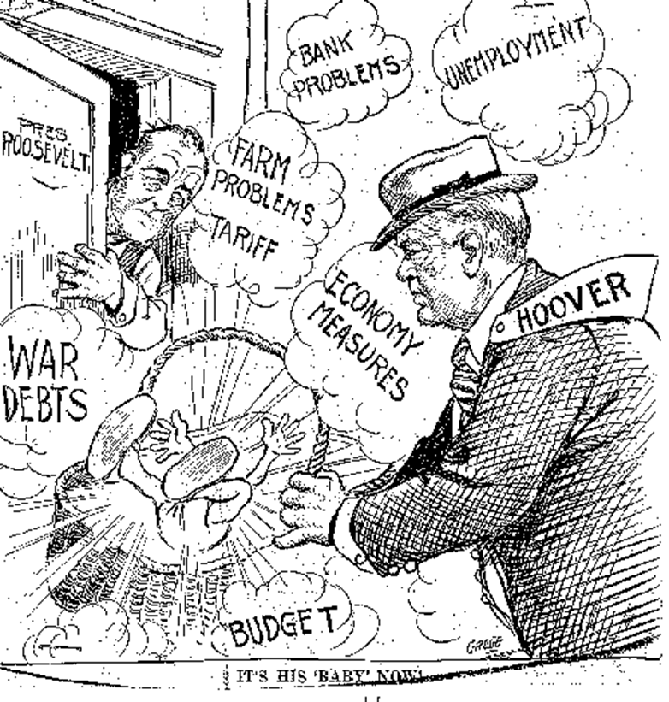

Slide 9
Election of 1932
Hoover refused to accept any responsibility for the economic downturn
Campaign slogans: “The Worst is Past” & “Prosperity is Just Around the Corner”
Accused FDR of seeking the destruction of capitalism
Franklin Roosevelt preached a brand of cautious liberalism, rejecting Hoover’s conservatism & the radical approach of socialists & communists
Offered a New Deal for the “forgotten man” & promised a balanced budget along with economic reforms
Campaign slogans: “Happy Days are Here Again” signaled Democratic optimism in face of economic problems

Slide 10
Election of 1932
Though party platforms were remarkably similar, Democrats supported repeal of Prohibition & an increase of federal relief.
FDR won 57% of popular vote & Democrats took control of both House & Senate
Following long lame-duck period for Hoover & Republicans (Nov to March), FDR launched Hundred Days of Legislative changes
Relief: for needy
Recovery: economic
Reform: financial
Bank Holiday: March 5th closed all banks to prevent further withdrawals
Fireside Chats- Radio talks by Roosevelt to encourage Americans

Slide 11
Dust Bowl
Drought from Texas to North Dakota
Over production of crops & burnt soil
1934 windstorm carried dust to the east coast
Okies- thousands of Oklahoma’s who picked up & traveled Route 66 to California

Slide 12
Relief Programs
Act or Program | Acronym | Year | Significance
Agricultural Adjustment Act | AAA | 1933 | Protected farmers from price drops by providing crop subsidies to reduce production, educational programs to teach methods of preventing soil erosion.
Civil Works Administration | CWA | 1933 | Provide public works jobs at $15/week to four million workers (1934)
Civilian Conservation Corps | CCC | 1933 | Sent 250,000 young men to work in camps to perform reforestation & conservation tasks. Removed surplus of workers from cities, provided healthy conditions for boys, provided $ for families.

Slide 13
Relief Programs
Act or Program | Acronym | Year | Significance
Federal Emergency Relief Act | FERA | 1933 | Distributed millions of $ of direct aid to unemployed workers
Glass-Steagall Act | FDIC | 1933 | Created federally insured bank deposits ($2,500 per investor) to prevent bank failures.
National Industrial Recovery Act | NIRA | 1933 | Created NRA to enforce codes of fair competition, minimum wage, and to permit collective bargaining of workers.
Public Works Administration | PWA | 1933 | Received $3.3 billion appropriation from Congress for public work projects

Slide 14
Relief Programs
Act or Program | Acronym | Year | Significance
Social Security Act | SS FICA | 1935 | Response to critics (Dr. Townsend & Huey Long), it provided pensions, unemployment insurance, & aid to blind, deaf, disabled & dependent children
Tennessee Valley Authority | TVA | 1933 | Federal government build series of dams to prevent flooding & sell electricity. 1st public competition with private power industries
Works Progress Administration | WPA | 1935 | Employed 8.5 million workers in construction & other jobs, but more importantly provided work in arts, theater & literary projects

