Slide 1
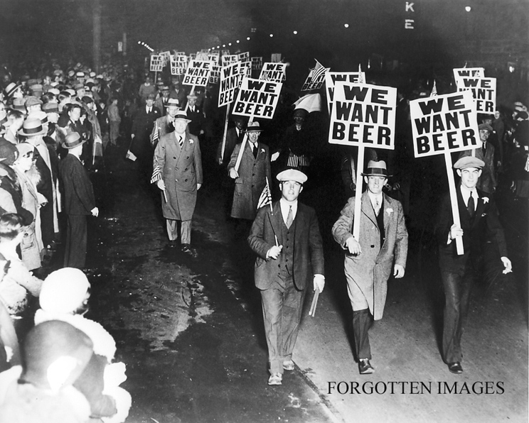
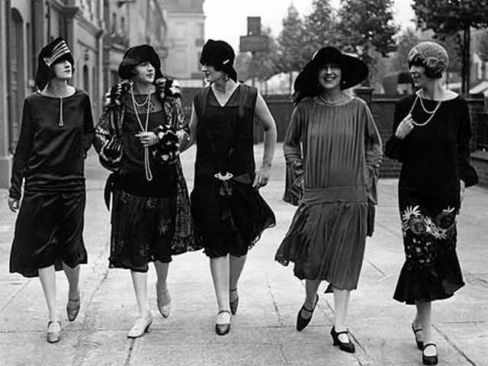
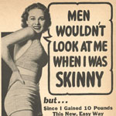
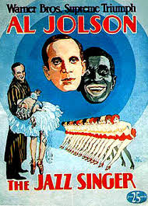
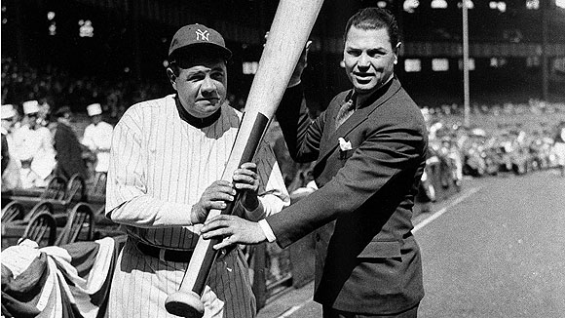
Unit #7: Roaring Twenties

Slide 2
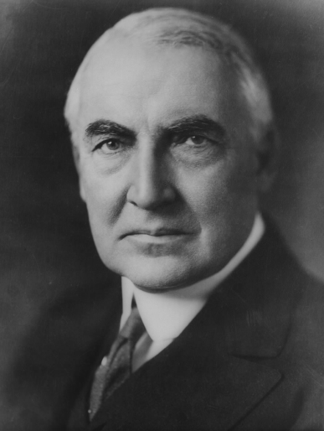
Presidency & Politics
Peace, Prosperity & small gov’t
Republicans & Laissez Faire rule the day.
1920 the 19th Amendment guaranteed women the right to vote.
Women asked for Equal Rights Amendment
1923 Alice Paul led the National Woman’s Party in a major reform campaign
Women first helped elected Warren G. Harding
Warren G. Harding:
Won election of 1920, 16 M vote to 9 M
VP Calvin Coolidge
Appointed a cabinet of the “best minds” of the Republican Party. Cabinet cut spending by 1/3 & Gov’t made money.
Revenue Act of 1921 cut business taxes

Slide 3
Presidency & Politics
Scandal- an event that hurts the reputation or makes someone less believable & trustworthy
Corruption- illegal activities by gov’t officials that causes them to lose the confidence of the people
Tea Pot Dome Scandal- Sec. of the Interior Albert Fall leased gov’t oil holdings to private companies at a low price in exchange for personal bribes.
Thomas Miller accepted $50,000 bribe from foreign interests to sell them WWI European land at a very cheap price.
Attorney General Harry M. Daugherty was being bribed by bootleggers to look the other way while Prohibition laws were broken.

Slide 4
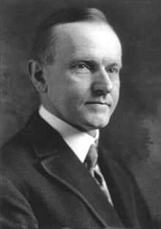
Presidency & Politics
Harding dies in 1923.
Calvin Coolidge (Silent Cal) “the business of America is business”
Clear out all Harding’s buddies
Leave everything else alone

Slide 5
Business Boom
5 main sources of Economic Boom:
Effect of WWI technology:
During the war, a significant labor shortage, combined with the need for increased production, necessitated new, more efficient methods of production.
Scientific Management: “Taylorism”
Frederick Taylor preached that businesses should focus on efficiency, speed, and elimination of unnecessary.
Rapid increase in worker productivity
Workers earned higher wages & became better consumers.
Installment plans encouraged Americans to build debt in order to buy goods.
Psychology of consumption
Conspicuous consumption became prevalent.

Slide 6
Business Boom
Examples of Conspicuous Consumption:
Radio
1st commercial radio station in Pittsburgh in 1920s
By 1922, 3 M America households had radios, and by 1929 purchase of receivers had increased by 2,500%, annual sales of $850 M
Motion Pictures
Industry became one of the 10 largest industries in the US. In 1922, theaters sold 40M tickets a week, by 1929 that number had grown to 100 M a week.
New Electric appliances
vacuum cleaners, toasters, washing machines, refrigerators.
Women became America’s greatest consumers
Automobile Industry
Annual automobile production rose from 2 M in 1920s to 5.5M in 1929
By late 20’s, there was one automobile for every 5 Americans

Slide 7
Automobile Industry
1908 Model T Ford was produced every 14 hours. By 1924 one was produced every 93 minutes.
3 Major car companies: Ford, General Motors, Chrysler
Economic Effects of the Automobile:
Promoted growth of other industries; petroleum, rubber, & steel
National Highway System was created. Automobiles required better roads. After WWI, federal funds became available for building highways and major industry was born.
Created new service facilities: filling stations, garages, roadside restaurants, motels (blend of motor & hotel, along roadside)

Slide 8
Social Effects of the Automobile
Created a more mobile society:
New traditions, “Sunday drive” with city folks going out to the country
Rural Americans came into urban areas for shopping and entertainment
Broke down the stability of family life:
Easier for individual family members to go their own way
Broke down traditional morality:
Children could escape parental supervision, as cars became “bedroom on wheels”
Suburbs grew outside the cities:
Businesses moved out of the cities

Slide 9
Economic Boom
This was a period of rapidly growing prosperity.
Production was no longer the problem, distribution was the problem.
Advertising grew: Albert Lasker made OJ the breakfast drink of America
Installment buying: buying something and paying for it in small payments.
Durable goods: things that you buy that will last for several years; ex: Radios, refrigerators, vacuum cleaners, cars, etc.
Stock Market Investment boom! Businesses were making a profit and everyone wanted to get rich quick.
Manufacturing costs declined
Everyone was buying stock
Chain stores increased distribution
Extension of credit gave the average American an opportunity to buy

Slide 10
Fun, Fun, Fun
A time where fun & excitement were the main interests.
Things changed rapidly: Morals, Trends, Fashions, Fads
Flapper- a woman who displayed her individuality by dressing wildly & acting however she wanted. This was the 1st time women attempted to be equal.
Bobbed hair, flattened chests, make-up, smoking, drinking and mini-skirts.
Jazz- the only true American music. Jazz allowed many blacks to experience new freedoms.
Heroes of the Jazz Age:
Charlie Chaplin- very successful movie artist
Al Jolsen- appeared in 1st talking movie, “The Jazz Singer”
Charles Lindberg- 1st to fly solo across the Atlantic Ocean

Slide 11
Fun, Fun, Fun
Heroes of the Jazz Age:
Duke Ellington & Louis Armstrong- jazz musicians
Jim Thorpe- Am. Indian who won gold in Olympics & played professional baseball & football
Red Grange- professional fb, 12 mins; scored 4 TDs and ran 263 yds
Gertrude Ederle- swam the 31 mile wide English Channel
Walt Disney- 1928 Mickey Mouse debuted in Steamboat Willie
Paul Robeson- Broadway actor who stared in Othello & Showboat
F. Scott Fitzgerald- wrote The Great Gatsby
T.S. Elliot- wrote The Wasteland
Langston Hughes- poet, wrote The Dream Deferred

Slide 12
Prohibition
18th Amendment (1918)- prohibited the manufacture or sale of alcoholic beverages
Volstead Act of 1919- defined an alcoholic beverage as one with an alcoholic content greater than 0.5%
Speakeasy- secret places to drink or illegal bars.
Bootleggers- illegal producers & distributors of alcohol
Gangsters- criminal leaders such as Al Capone
Seized control of illegal liquor sales
Rival gangs fought over sales territory
IRS estimated Capone’s wealth at $105M in 1927
1931 Capone convicted of Tax Evasion and sent to prison
Consumption of liquor often rose to the point where problems outweighed the benefits so 21st Amendment ended Prohibition in 1933.

Slide 13
Organized Fear = Hate, intolerance & Conflict
Isolationism created a fear of anything that was outside of the US.
Antiradicalism- fear of radicals (people who wanted to make BIG changes quickly.)
Many believed that radicals threatened the American way of life
Radicals included labor organizers, women’s leaders, black leaders, anyone who opposed the way things had be done.
Red Scare- The Bolshevik (or October) Revolution in 1917 brought Communism to Russia
It was supposed to spread throughout the world under the slogan “Workers of the World Unite”
16 homemade bombs were found wrapped up and addressed to prominent members of commerce & gov’t (Morgan, Rockefeller, Sup. Ct. Judge Holmes). Many thought this was part of the Bolshevik Conspiracy

Slide 14
Organized Fear = Hate, intolerance & Conflict
Americans began to fear anyone who immigrated recently (especially if they were radical).
Palmer Raids: Attorney General Palmer ordered the Justice Dept. to raid meeting halls and homes of suspected Commies.
6,000 people were arrested but never charged
Eventually Palmer’s tactics began to offend even conservative Americans and support for the Red Scare dropped off.
Anarchists- those who wanted to overthrow anyone who was in power, usually through the use of violence.
The Immigrant Act allowed anarchist & terrorists to be deported

Slide 15
Organized Fear = Hate, intolerance & Conflict
Industrial Workers of the World (IWW or Wobblies) used in your face tactics attempting to achieve their goals of unionizing all workers and overthrowing capitalism
Boycotts, strikes, & sabotage were main methods of choice
Sacco & Vanzetti- well-known Italian immigrants & anarchist radicals
A shoe factory robbery became violent when two guards were killed. The only identification of the robbers was that they “looked Italian.”

Slide 16
Urban Black Activism
Marcus Garvey- Jamaican Immigrant
Founded the Universal Negro Improvement Association
Believed that African Americans had to look to their own culture as a source of dignity and pride
Promote Black investment in business, restaurants, grocery stores & manufacturing
Started the “Black Star Line” steamship company to transport Am to visit Africa
1923 Black Star went broke, Garvey was convicted of fraud, sent to prison, & deported.
W.E.B Du Bois
Formed the National Association for the Advancement of Colored People (NAACP)

Slide 17
Ku Klux Klan
Resurgence of the KKK feeling threatened not only by Blacks but also Jews & Catholics
New KKK promoted “100% Americanized”
Main targets:
Roman Catholics. The pope was called a “political autocrat” intent on taking over the world. The Klan insisted that it was impossible for anyone to be a good American citizen & a good Roman Catholic at the same time.
Jews were denounced as internationalists who could never form deep attachments to America which came naturally to Protestant, Anglo-Saxon Americans
African-Americans. Like its predecessor, this new KKK was also militantly anti-black, according to Hiram Wesley Evans an “Imperial Wizard”

Slide 18
Ku Klux Klan
Rosewood Tragedy: small rural black community in Florida
4 black men were arrested for the rape of a white woman
5 blacks and 2 whites were lynched in neighboring Ocoee in a dispute over voting rights
Vigilantes (KKKs) killed two of the men accused of the rape.
Rosewood was burned to the ground and several more citizens are killed.
A Grand Jury found insufficient evidence to convict anyone.

Slide 19
Fundamentalism:
Because of fear, people wanted to return to strong Christian values and strict guidance of the Bible. Even laws were changed to favor religious ideals. Fundamentalists tended to be Baptists, Methodists, or Presbyterian.
Scopes Monkey Trial:
John Scopes was a high school Biology teacher in TN. He was arrested for teaching Darwin’s theory of evolution to his students. This was thought to be anti-biblical.
World famous agnostic Clarence Darrow defended Scopes.
3 time Presidential candidate William Jennings Bryan prosecuted Scopes.
Darrow’s question was whether the state had the right to forbid the teaching of evolution.
Bryan believed he was defending God.
The ideas of Fundamentalism were put on trial against the ideas of separation of church & state.
Scopes was found guilty & sentenced to pay a $100 fine.

