Slide 1
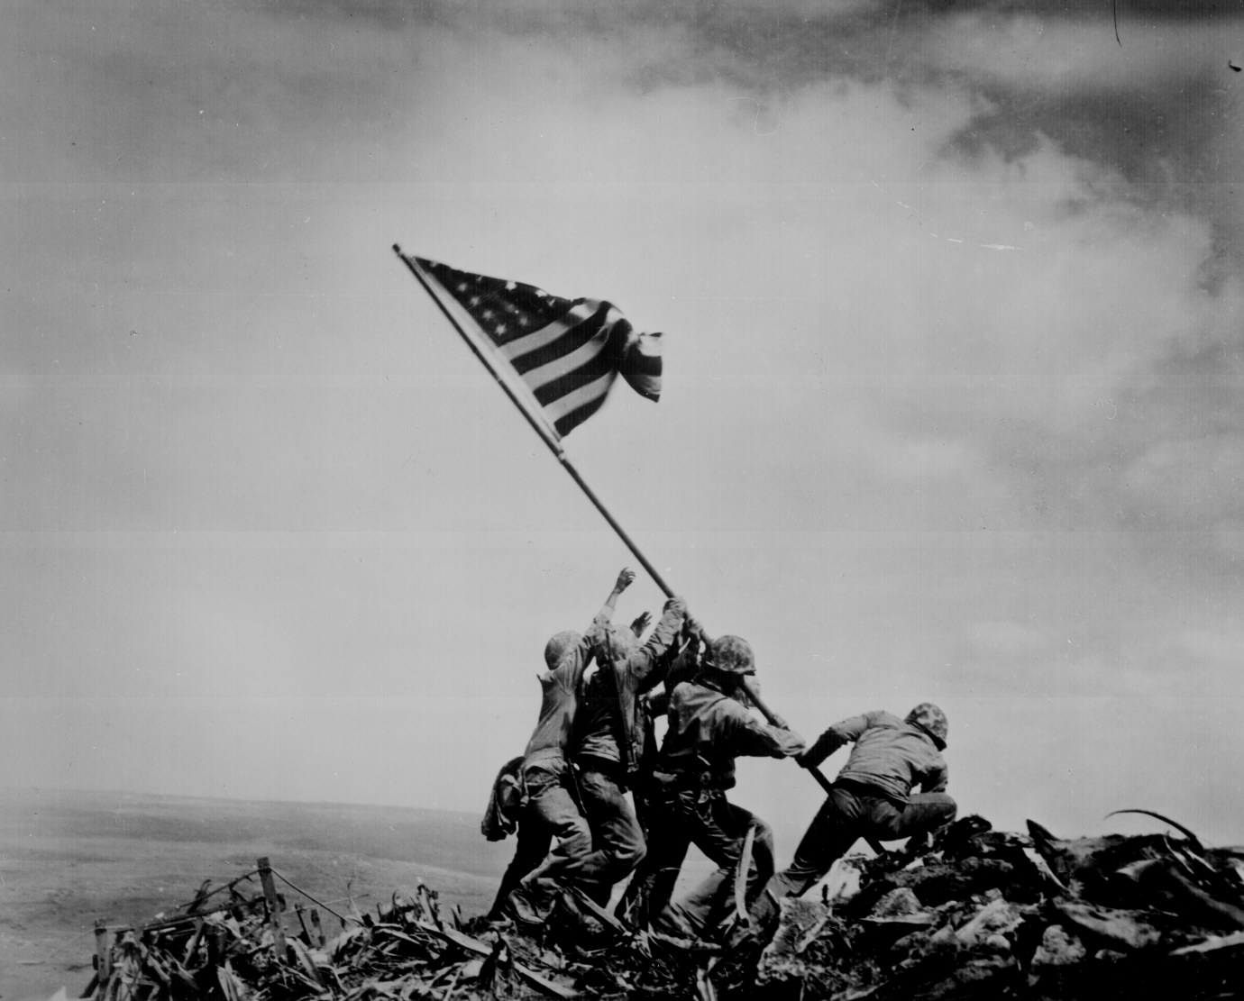
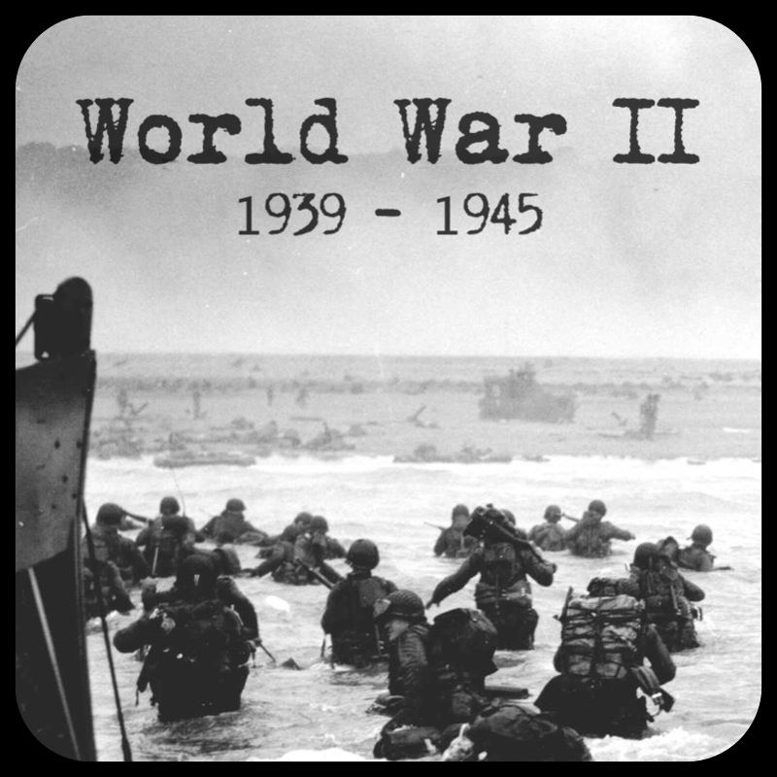
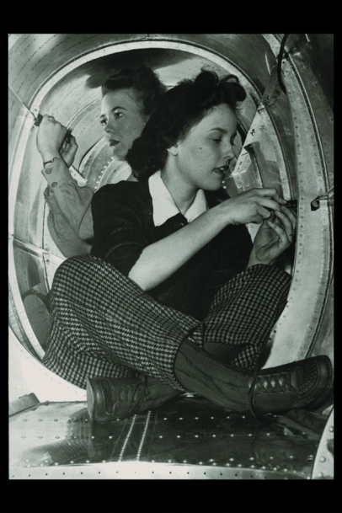
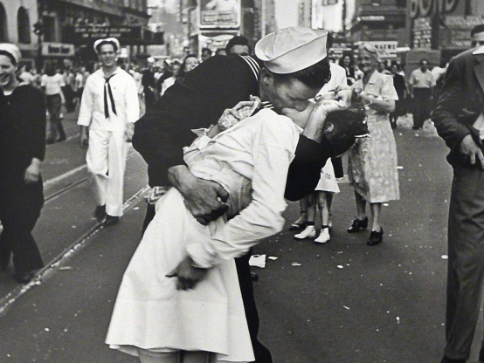
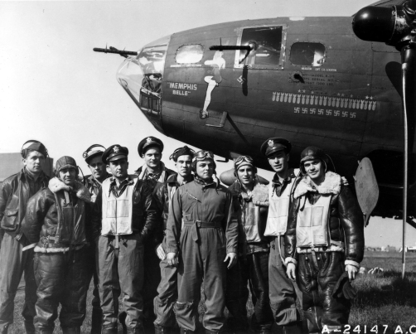
Unit #6: World War II

Slide 2
Economic Pressures
Many European nations urged the US to forgive the huge reparations they had accumulated during WWI.
Germany paid some of its reparations ($33 million) but fell behind on payments
American banks & investors loaned millions to Germany to help keep it solvent
Finally, Allies paid back only $2.6 billion out over $14 billion owed to the US. They defaulted on the rest.
American economic influence expanded during WWI. By 1929, the US
Produced half of the world’s industrial goods
Led the world in exports ($5.4 billion)
Private investment in overseas ventures increased 500%.
Many Europeans saw American economic expansion as imperialism.

Slide 3
International Disarmament & Peace Efforts
Washington Naval Conference (1921) set a ratio of naval tonnage among the 5 leading naval nations in an attempt to limit armaments.
Kellogg-Briand Pact (1928) 62 nations agreed to renounce war as a solution for international disputes.

Slide 4
Rise of Totalitarianism
Hitler was invited to join the German government as chancellor in 1933
He became dictator (total & absolute power)
Based his principle on his book Mein Kampf (“My Struggle”)
He proclaimed the racial superiority of Aryans (“pure” Germans- blue-eyed, blonde hair)
He declared the need for lebensraum (living space)
Rhineland (French controlled region) 1936
Annexation of Austria 1938
France & Britain appeased (gave in to demands to shut him up) Hitler at Munich in 1938 by agreeing not to oppose Germany’s seizure of German-speaking region of Czechoslovakia.
Anti-Semitism (anti-Jewish) reigned in Germany.
Concentration camps- Jews, Gypsies, Jehovah’s Witness, Homosexuals, mentally ill, physically disabled
Germany’s military was rebuilt in defiance of the Treaty of Versailles.

Slide 5
Rise of Totalitarianism
Mussolini seized power in Italy as the leader of the Fascist Party in the 1920s & began expanding military power in the 1930s.
Fascism- nation and state more important then individual
Unemployment & inflation had middle & upper classes to demand strong leadership.
Italy attacked in Ethiopia in 1935.
Italy then left the League of Nations.
Italy joined Germany in the Axis alliance.
Japan, led by increasingly influential military factions, seized Manchuria in 1931 & northern China in 1937.
League of Nations tried to stop them so Japan just quit league.

Slide 6
Growth of American Neutrality
Many Americans in Congress & the nation opposed any American involvement in international crisis.
Neutrality Acts- outlawed sale of arms or loans to nations at war.
After Hitler invaded Poland in 1939 & Great Britain and France declared war, FDR declared that the US would remain neutral in action, but made it clear that he favored the Allied cause.
Blitzkrieg- “lightning war”
He asked for a relaxation of Neutrality Act restrictions to allow war material to be purchased by Allied forces on a cash-and-carry basis.
Old American ships were traded to the British in exchange for the right to build military bases on British territory.
Neutrality was abandoned by the US in 1940 with lend-lease policies that gave FDR permission to give arms to the Allies.

Slide 7
World War II
The Home Front- term used to describe civilian support and participation in the war.
Women helped support the war effort
Served in various production capacities like WOW (Women of the War)
Volunteered for service: WAC (Women’s Army Corps), Waves, Spars.
As a result after the war women working was more or less an accepted part of society.
The average civilian was able to support the war.
Observe rationing. Products like silk & gasoline were not readily available.
Students and others collected scraps.
New Technology- nylon as opposed to the silk used parachutes
Massive gov’t and private investment to war industry.

Slide 8
Allied vs. Axis
Allied Powers
Great Britain (Chamberlain, then Churchill)
United States (Roosevelt)
And 24 other countries
Axis Powers
Germany (Hitler)
Italy (Mussolini)
Japan (Hirohito)

Slide 9
World War II
The Pacific Theater
Japanese Strategy
Dec. 7, 1941- Japan attacked Pearl Harbor. “Day which will live in infamy”
Sudden swift attack, wanted the US to refuse to fight
As the tide of the war turned they turned to Kamikaze Suicide attacks on ships.
American Response
General Douglas McArthur used the strategy of Island Hopping.
Turning Point at Midway and Coral Sea
Return to Philippine Islands at Guadalcanal & Bougainville
Landing fields gained at Tarawa, Tinian, Iwo Jima

Slide 10
World War II
European Theater
German Strategy
Blitzkrieg- Lightening War
Battle of Britain- continued bombing of England
Attack Soviet Union
American Response in Europe
Forces led by Supreme Commander in Europe Dwight David Eisenhower, General George Patton & Omar Patton were important.
Landings in North Africa
Landings in Italy
Operation Overlord- D-Day: Opening up of a second front in Normandy, France.
Turning points- Battle of the Bulge, Stalingrad
V-E day and V-J day
The American strategies were successful because. . .
Technology
Industrial might
Dropping of Atomic Bomb on Japan- Manhattan Project

Slide 11
Truman’s Decision
Roosevelt died while in office and Truman takes over.
Atomic Bomb dropped at Hiroshima & Nagasaki
Germans trying to develop nuclear weapons
The Manhattan Project was run by Dr. Robert Oppenheimer, a German Jew, who had fled the Nazis.
Truman decided to drop the atomic bomb because the army estimated that it would have cost between 500,000 to 1,000,000 soldiers lives to mount a successful full scale invasion of Japan.
Unconditional surrender of Japan.

Slide 12
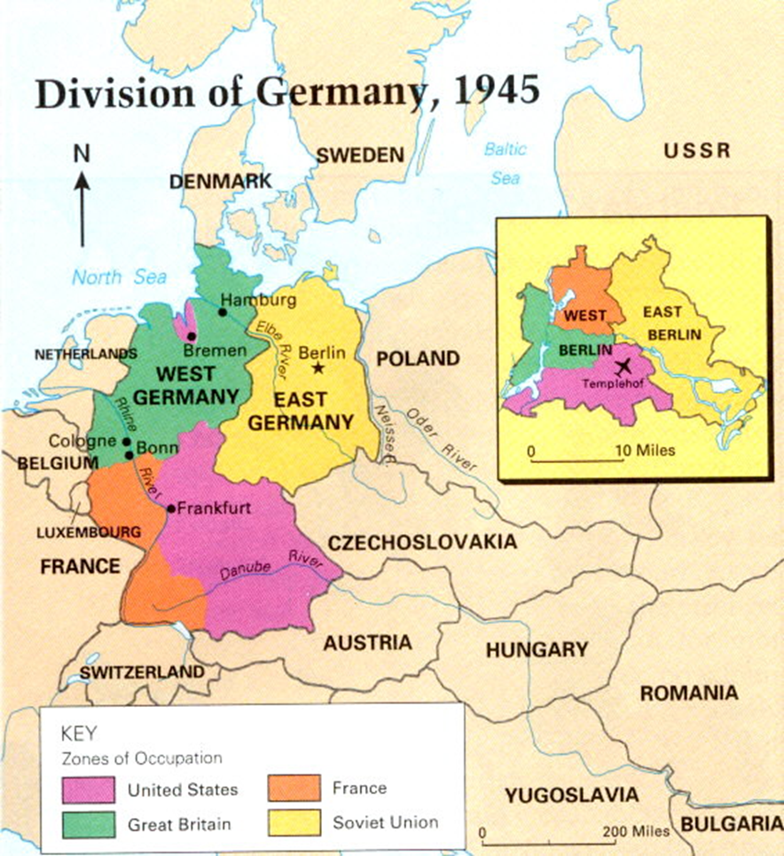
The Plan for after the WAR
Yalta Conference: Churchill, Roosevelt, Stalin meet
United Nations set up to help prevent another world war.
Plan for Europe
Germany was divided into 4 zones, Germany’s capital Berlin was divided.
America, England, and France reunited their sectors into democratic West Germany.

Slide 13
Stalin refused to reunited his section, creating communist dictatorship East Germany.
Marshall Plan announced.
America will rebuild Europe which prevents another depression & war by rebuilding markets and turning enemy into ally.

Slide 14
Plan for after the War
Japan occupied by the US forces
General MacArthur personally oversees transition to a democratic government.
Emperor Hirohito allowed to remain as figure head
Japan demilitarized
America rebuilds Japan so that we can turn enemy into ally and build markets for our goods.
Even the casual observer of history can see that America made dramatically different choices after WWII than WWI. Instead of retreating into isolation, America helped rebuild a new world order that would promote peace and stability.
Cold War Begins!

